Slide 1
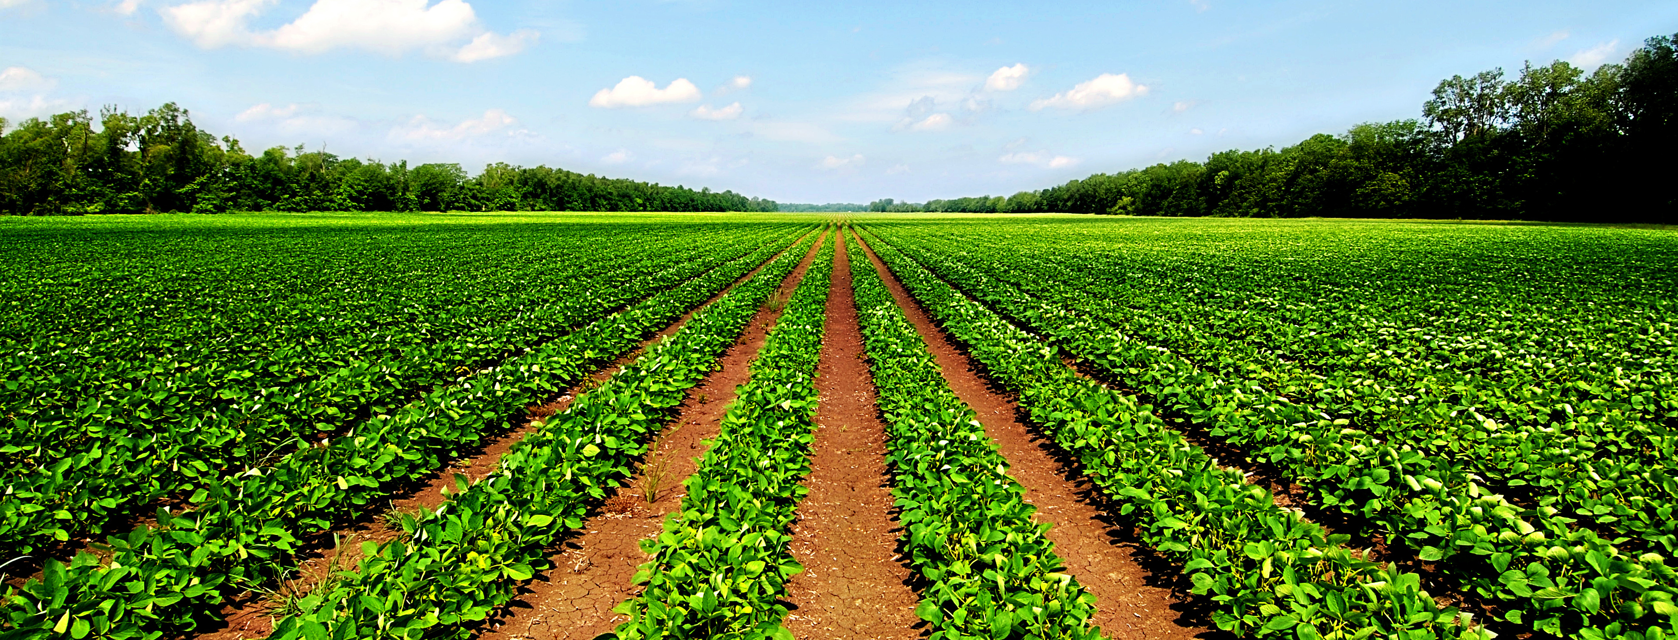
Intensive Agriculture
http://www.mountandminster.co.uk/wp-content/uploads/2013/07/Agric2.jpg

Slide 2
Table of contents
Definition
I) History
II) Characteristics :
a) Crops
b) Livestock
III) Positive aspects and limitations
Conclusion
Bibliography

Slide 3

Definition
Intensive agriculture:
“Farming that uses a lot of machinery, labour, chemicals, etc. In order to grow as many crops or keep as many animals as possible on the amount of land available.” (Cambridge Dictionary)

Slide 4
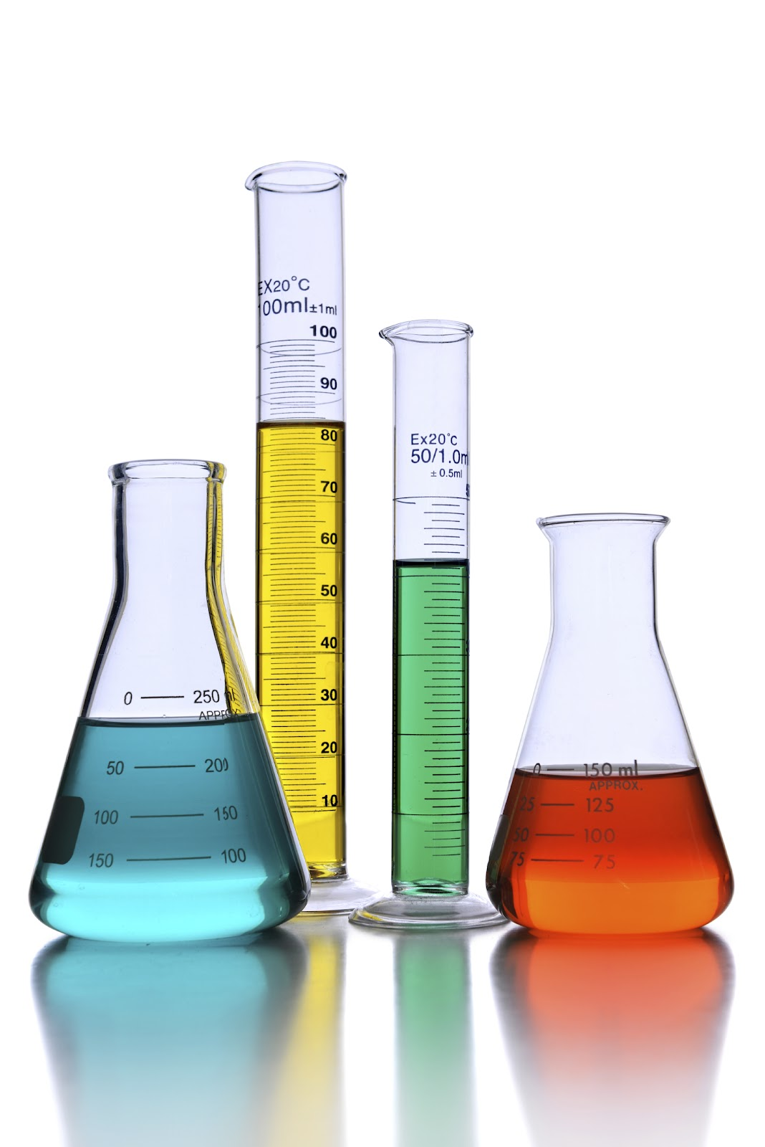
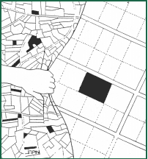
I) Historical background
Scientific progress during the industrial revolution:
- Fossil fuels
- Chemical products
- Mineral fertilizers
- Mechanization
Higher yields in the first part of the 20th
Real intensification during the Green Revolution (40s to 60s)
http://sentryair.com/blog/wp-content/uploads/2012/10/Chemicals1.jpg
http://www.landgovernance.org/assets/p30graphic01.gif

Slide 5
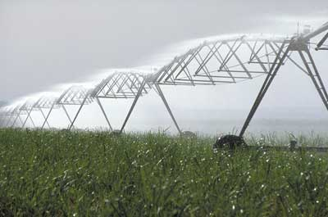
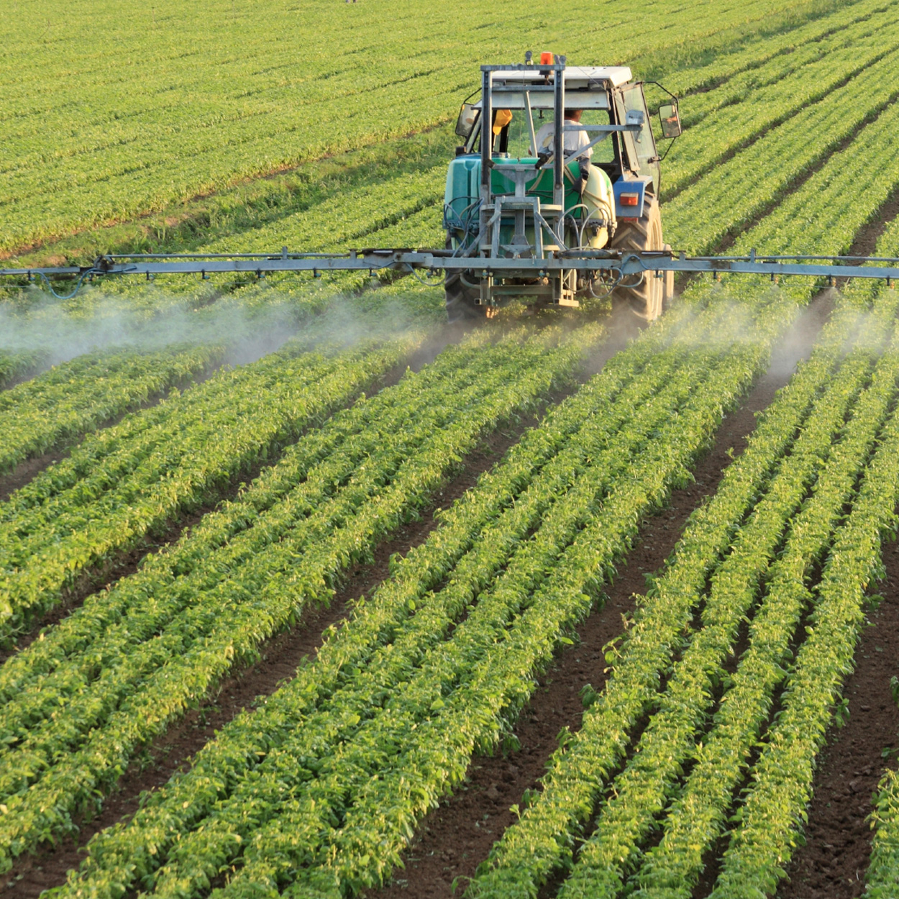
II) Characteristics a) Crops
Hybrid seeds/GMO
Mineral fertilizers
Large scale irrigation
Monoculture
Weed control with herbicides
Pests and diseases management with
pesticides
https://oxfamblogs.org/education/water_for_all/water/problem/irrigate/images/one_spray.jpg
http://www.solerasd.com/wp-content/uploads/2014/02/Herbicide-Image1.jpg

Slide 6
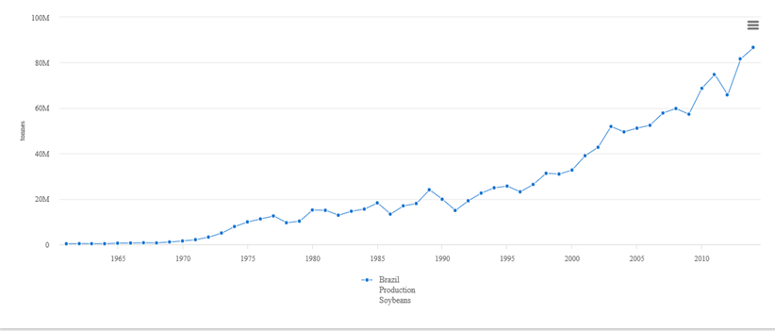
Brazil soybeans production from 1961 to 2014
http://www.fao.org/faostat/en/#compare

Slide 7
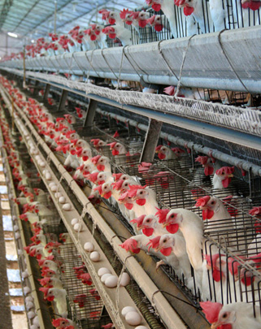
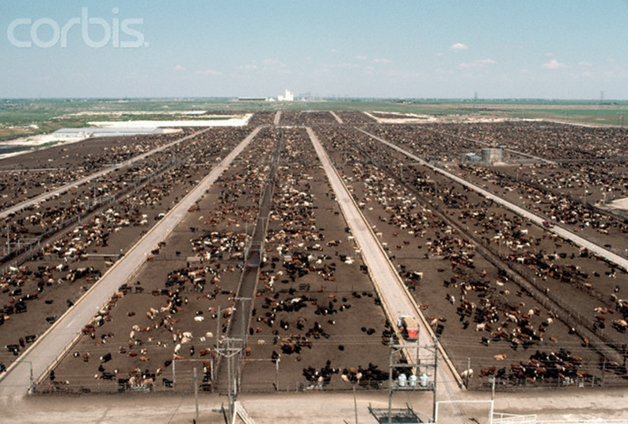
b) Livestock
High animal density
Feedlots
Disinfectants, antimicrobial agents, anthelmintics, hormones, vaccines and antibiotics
More efficient breed (confinement resistance, fast raise)
https://en.wikipedia.org/wiki/Intensive_animal_farming#/media/File:Battery_hens_-Bastos,_Sao_Paulo,_Brazil-31March2007.jpg
http://www.owlmeds.com/wp-content/uploads/2015/08/feedlot.jpg

Slide 8
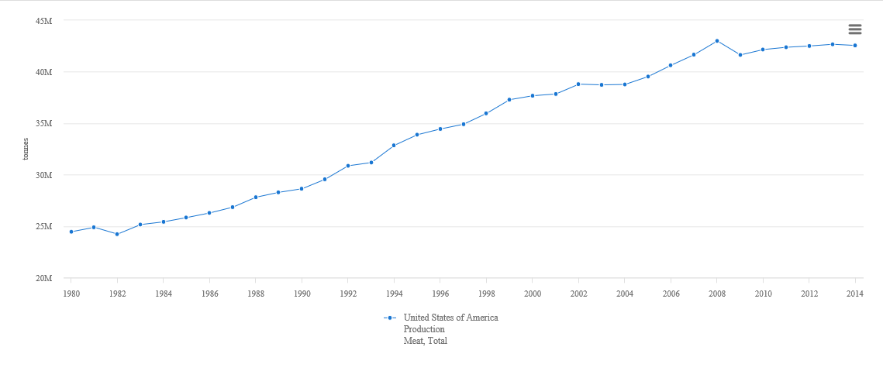
Meat production in USA from 1980 to 2014
http://www.fao.org/faostat/en/#compare

Slide 9
III) Positive aspects
Higher yields in crops, meat
Smaller spaces needed per unit
Lower production costs
Less human labour per unit of land

Slide 10
And limitations
Needs a lot of inputs
Degrades the soil fertility
Produces fertilizers and pestiscides waste
Depends on fossil fuels and mineral products
Emits a significant amount of greenhouse gases

Slide 11
Conclusion
Nowadays, intensive farming allows to produce a huge quantity of food in a small area thanks to scientific progress and mechanization.
However, this type of agriculture needs a lot of energy and inputs to work.
This model is not sustainable because of its impact on the environment.

Slide 12
Bibliography
http://dictionary.cambridge.org/dictionary/english/intensive-agriculture
http://geography.about.com/od/globalproblemsandissues/a/greenrevolution.htm
https://global.britannica.com/topic/intensive-agriculture
http://www.mountandminster.co.uk/wp-content/uploads/2013/07/Agric2.jpg
http://sentryair.com/blog/wp-content/uploads/2012/10/Chemicals1.jpg
http://www.landgovernance.org/assets/p30graphic01.gif
https://oxfamblogs.org/education/water_for_all/water/problem/irrigate/images/one_spray.jpg
http://www.solerasd.com/wp-content/uploads/2014/02/Herbicide-Image1.jpg
https://en.wikipedia.org/wiki/Intensive_animal_farming#/media/File:Battery_hens_-Bastos,_Sao_Paulo,_Brazil-31March2007.jpg
http://www.owlmeds.com/wp-content/uploads/2015/08/feedlot.jpg

